Slide 1

Computer Vision and Convolutional Neural Network
Abdullah Saihan
Artificial Intelligence Engineer

Slide 2
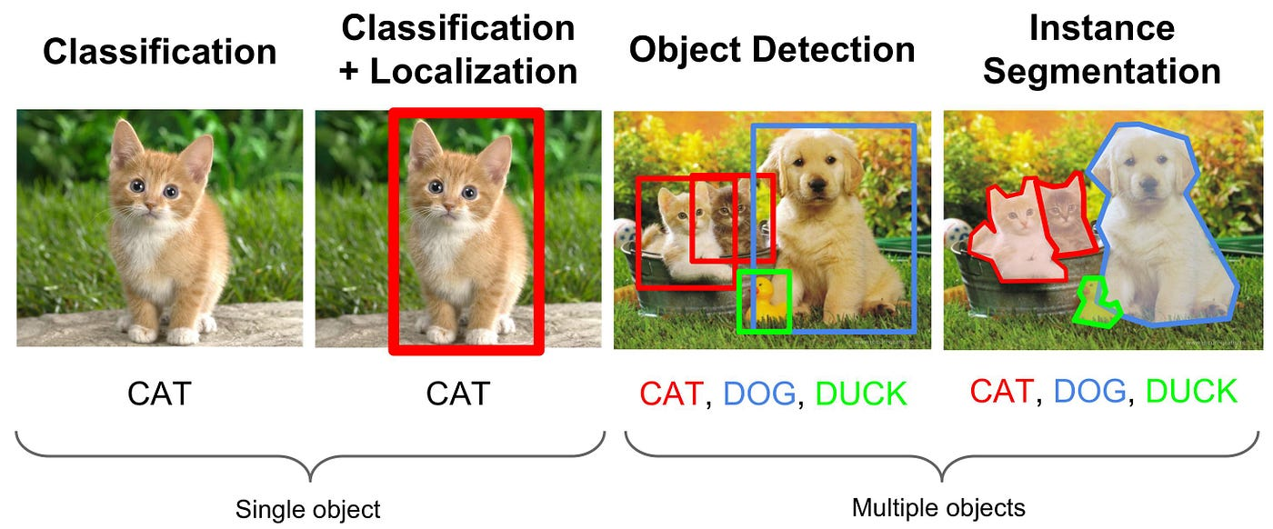
Computer Vision Application

Slide 3
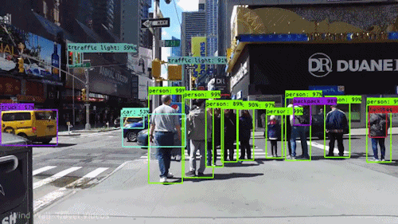
Object Detection

Slide 4
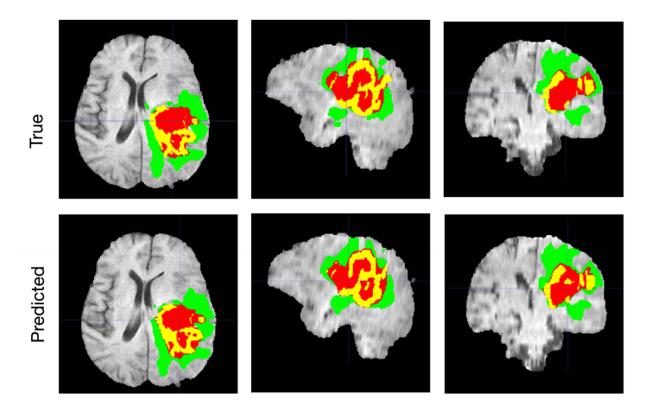
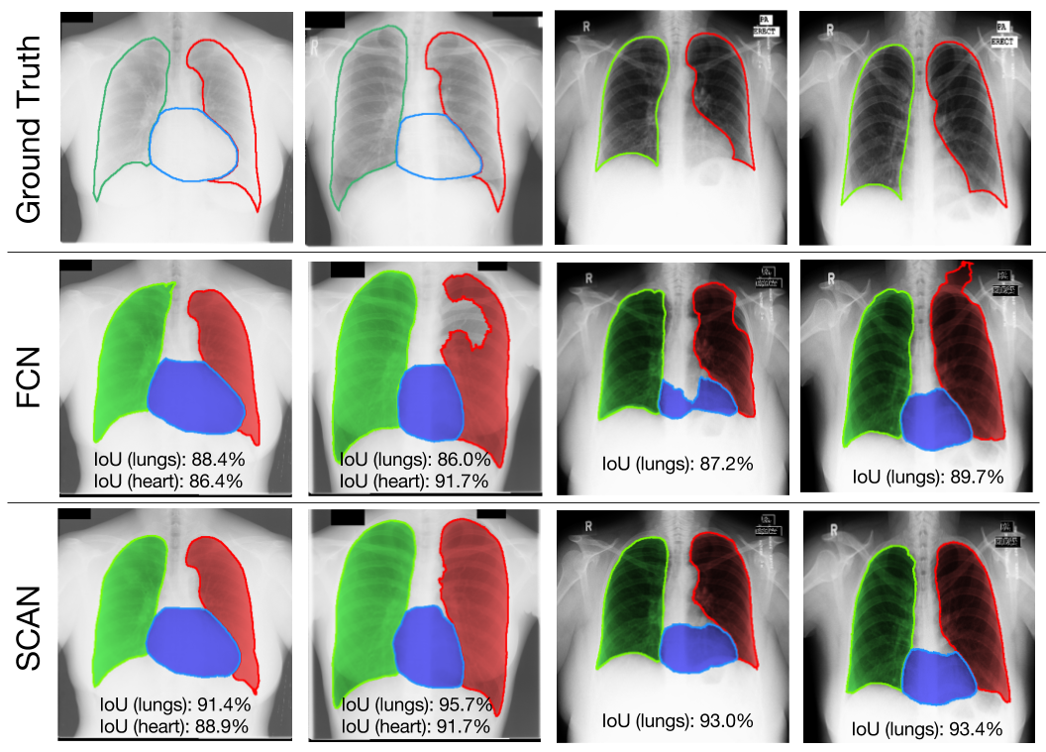
Medical Imaging

Slide 5
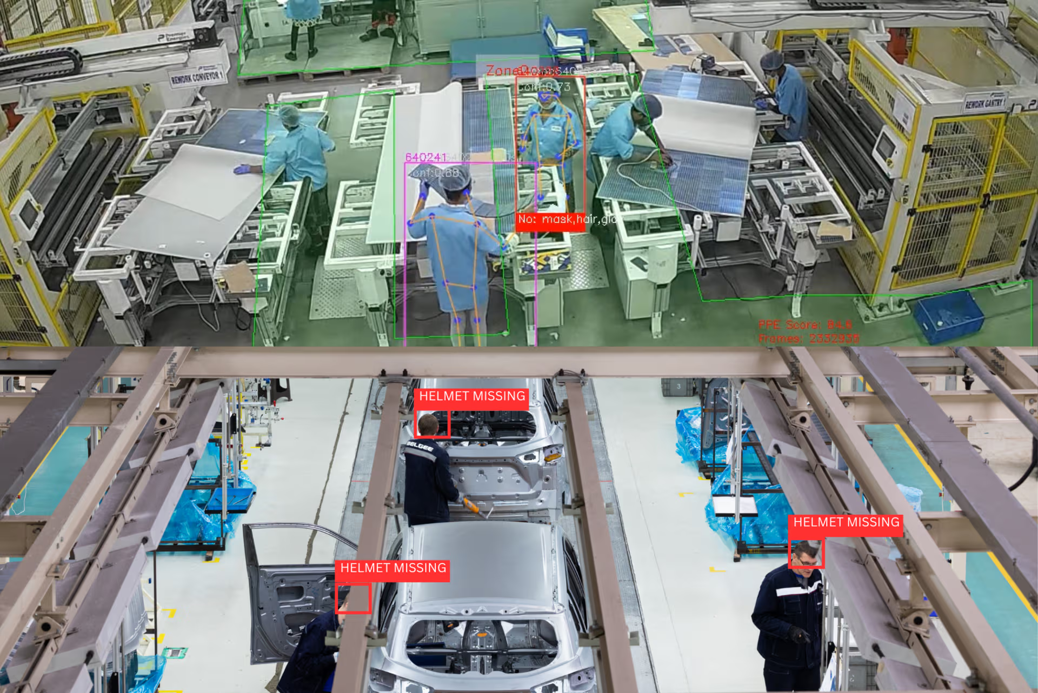
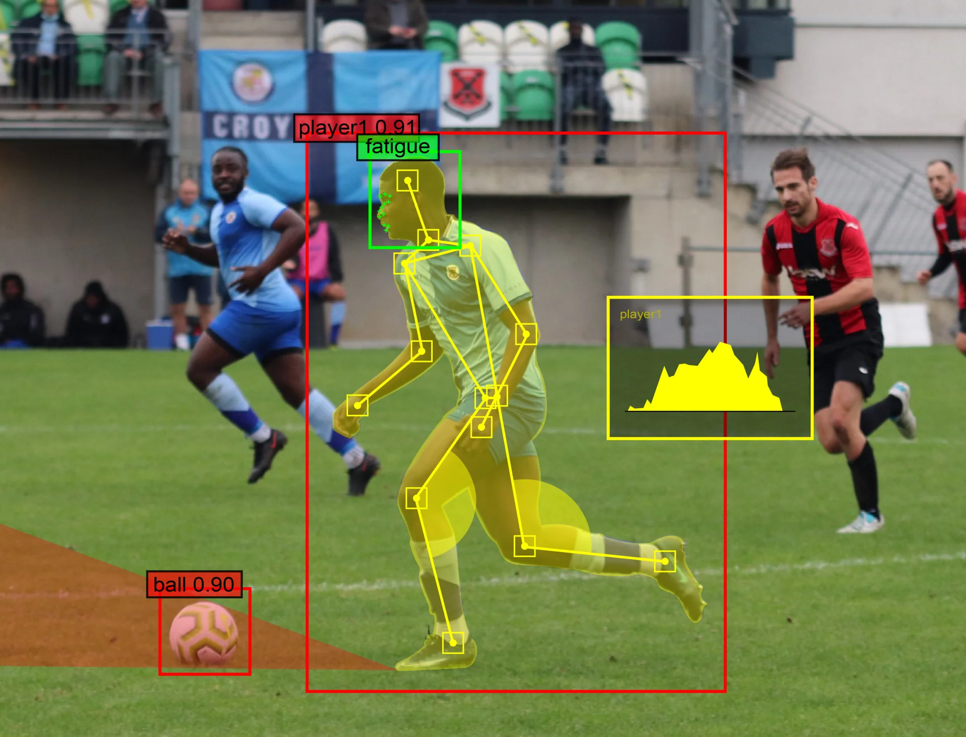
Manufacturing and Sports

Slide 6
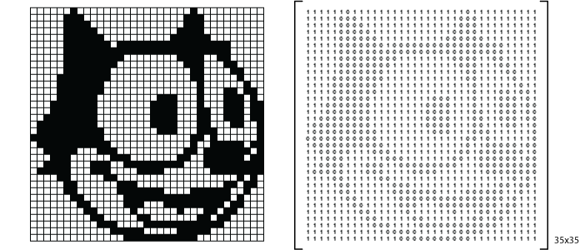
Images are Fundamentally Metrics

Slide 7
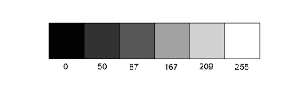
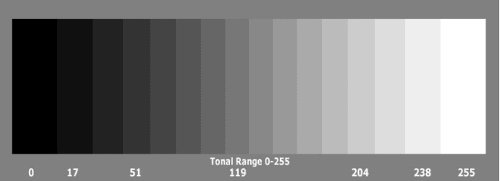

Slide 8
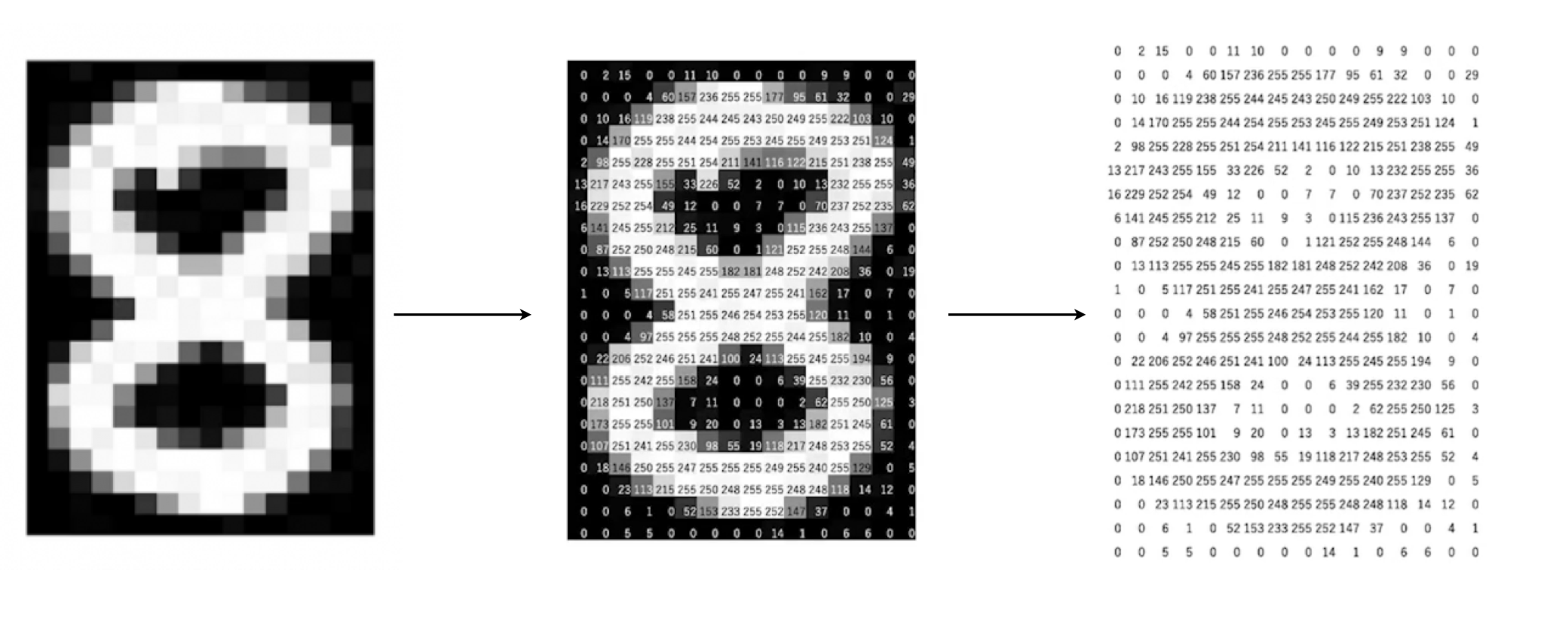

Slide 9
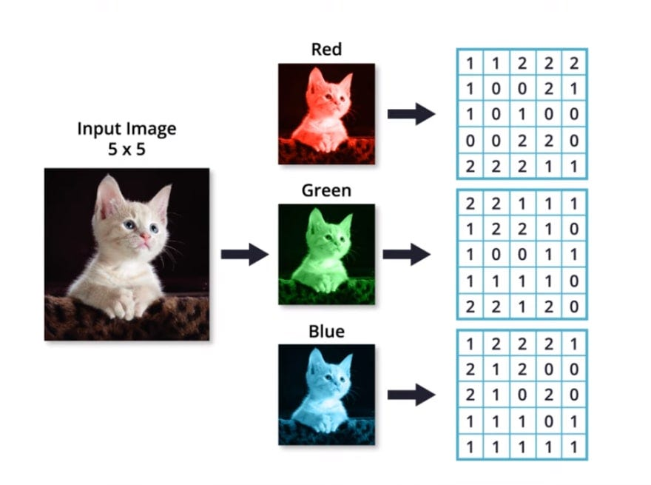
RGB Image

Slide 10
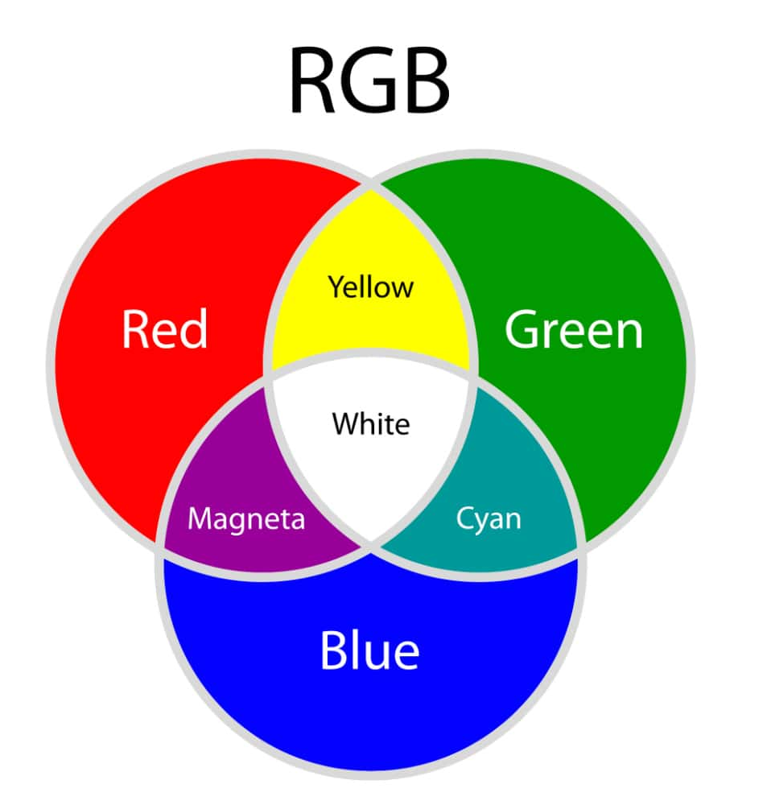
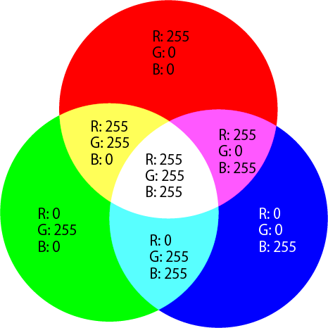
Color Theory

Slide 11
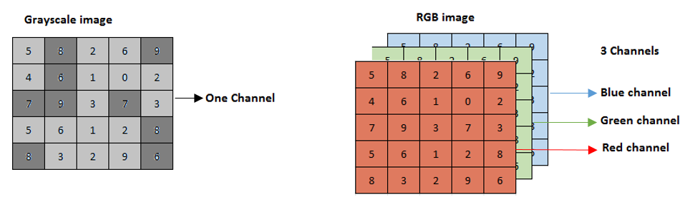
Image Channel

Slide 12
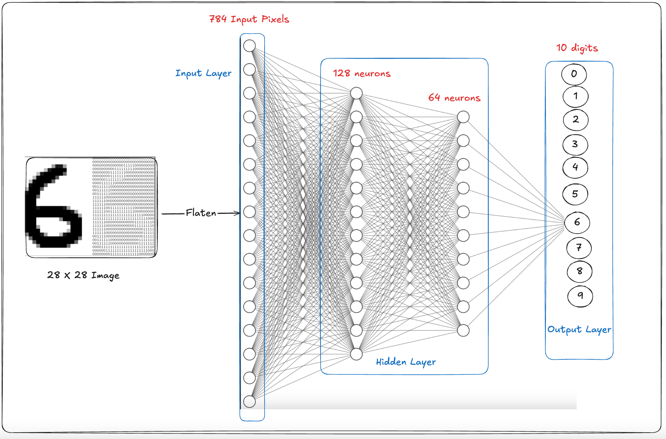
ANN for Image

Slide 13
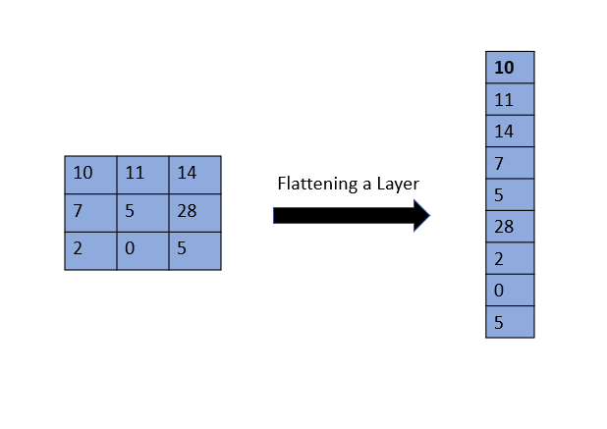

Slide 14
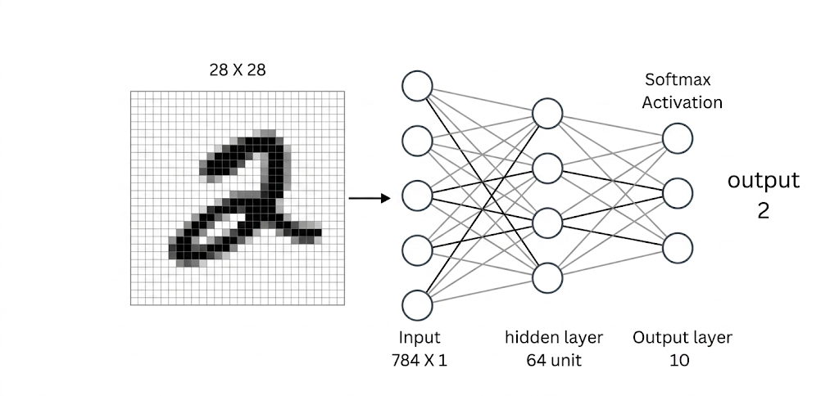

Slide 15
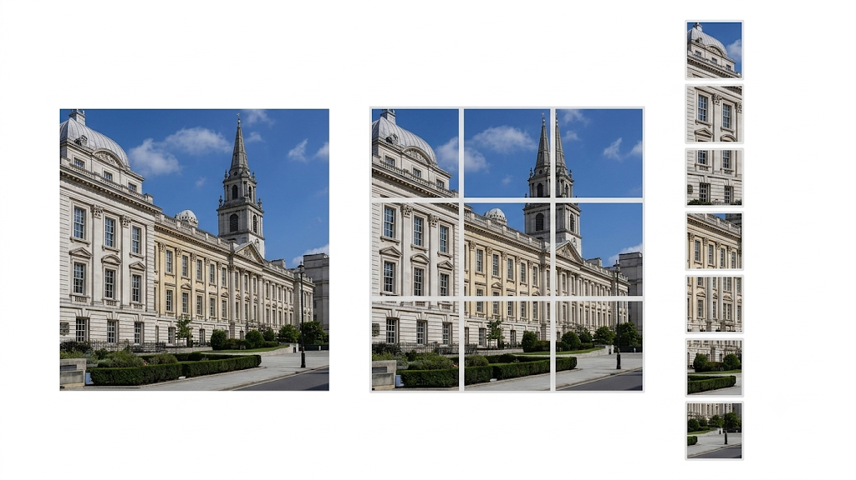

Slide 16
Loss of Spatial Information
Nature of Image Data
Images contain spatial information, not just numbers
Nearby pixels are related (local patterns)
Edges, shapes, and textures matter
Feature location is important
Problem with ANN:
Image is flattened into a 1D vector
Loses pixel relationships and spatial structure
Example:
100×100 Image → 10,000 pixel values

Slide 17
Massive Number of Parameters
ANN uses fully connected layers
Example:
Image: 100×100 = 10,000 inputs
Hidden layer: 100 neurons
Parameters:
10,000 × 100 = 1,000,000 weights
For large images:
Huge memory usage
Slow training
More overfitting risk

Slide 18
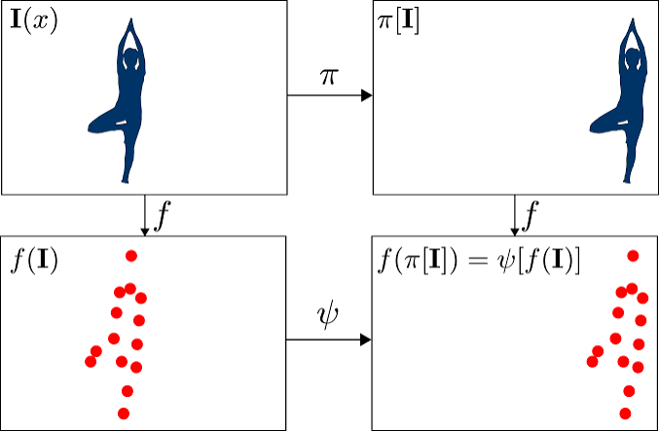
Loss of Translational Invariance
Objects can appear anywhere in an image
In one image, the dog is on the left.
In another image, the dog is on the right.
Basic ANN:
Treats them as different patterns
Needs to learn each position separately
CNN:
Detects the same feature anywhere in the image
Better handles object movement/position changes

Slide 19
An image filter is a mathematical or digital process that changes the pixels of an image to alter its colors, reduce noise, or highlight specific features like edges and shapes .
Image Kernels explained visually

Slide 20
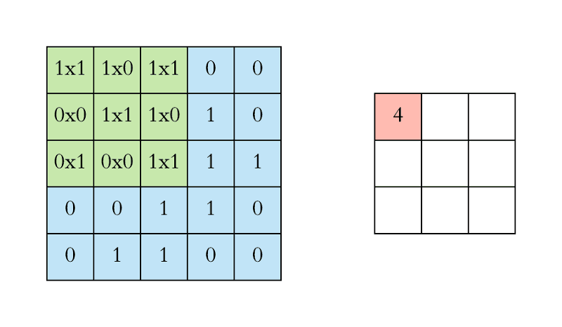
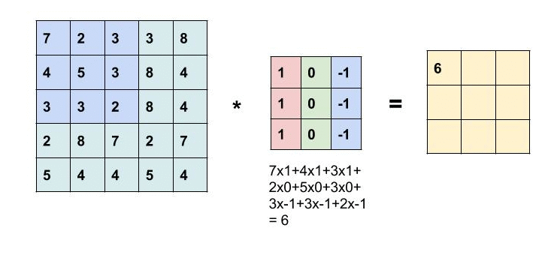
Convolution

Slide 21
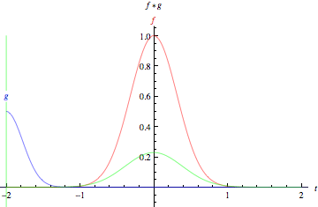

Slide 22
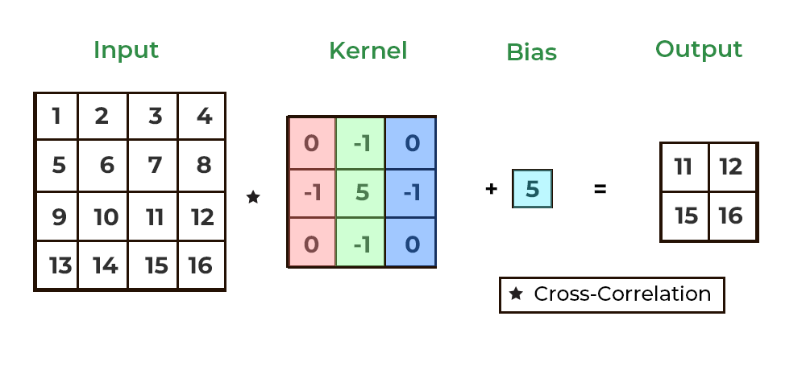

Slide 23
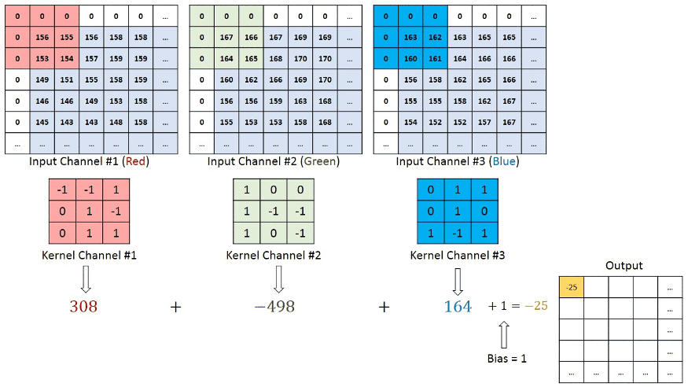
RGB Convolution

Slide 24
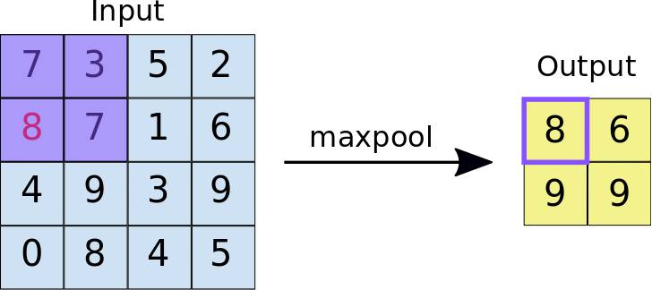
Max Pooling

Slide 25
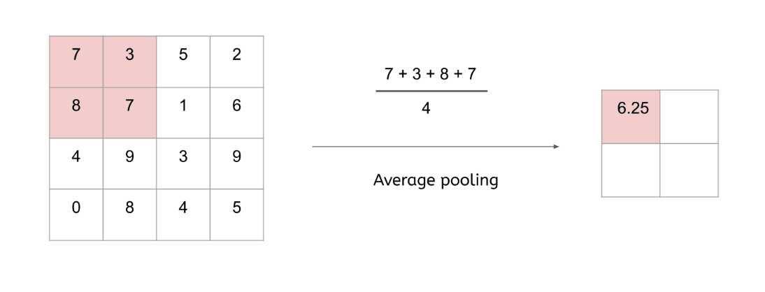
Average Pooling

Slide 26
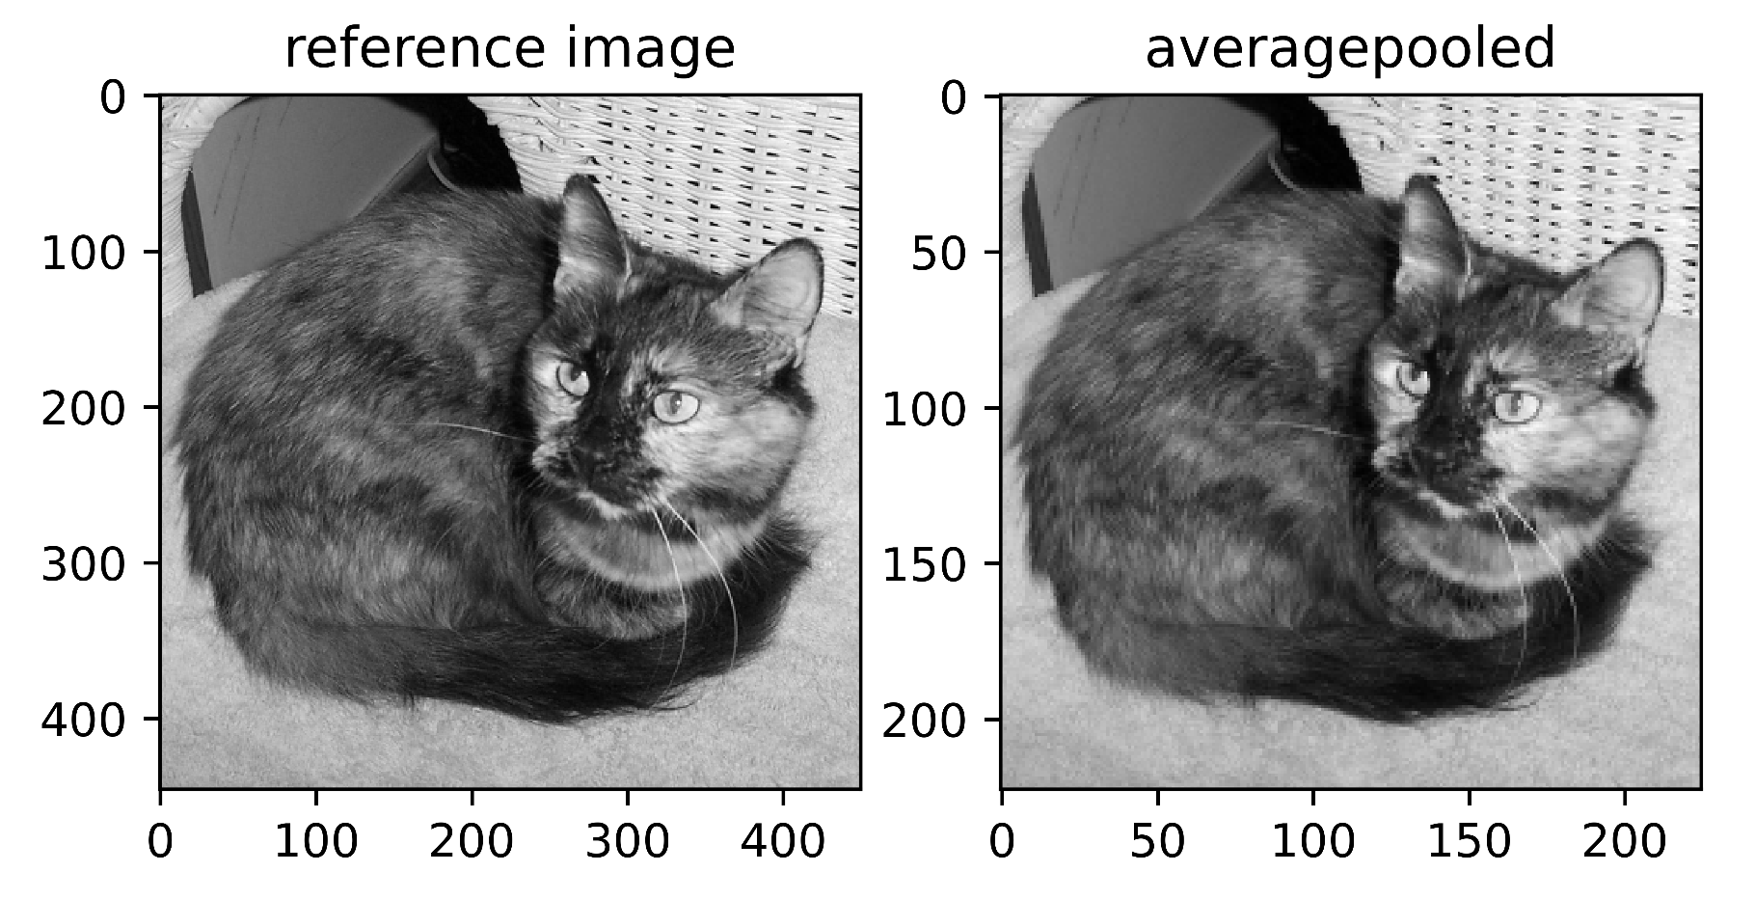

Slide 27
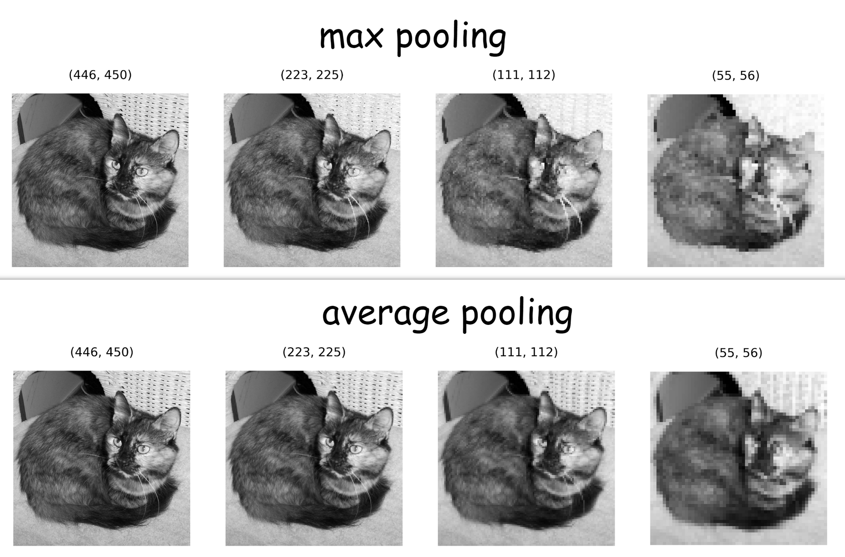

Slide 28
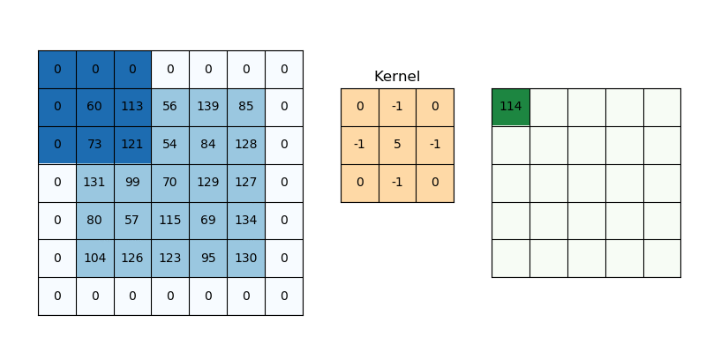
Padding

Slide 29
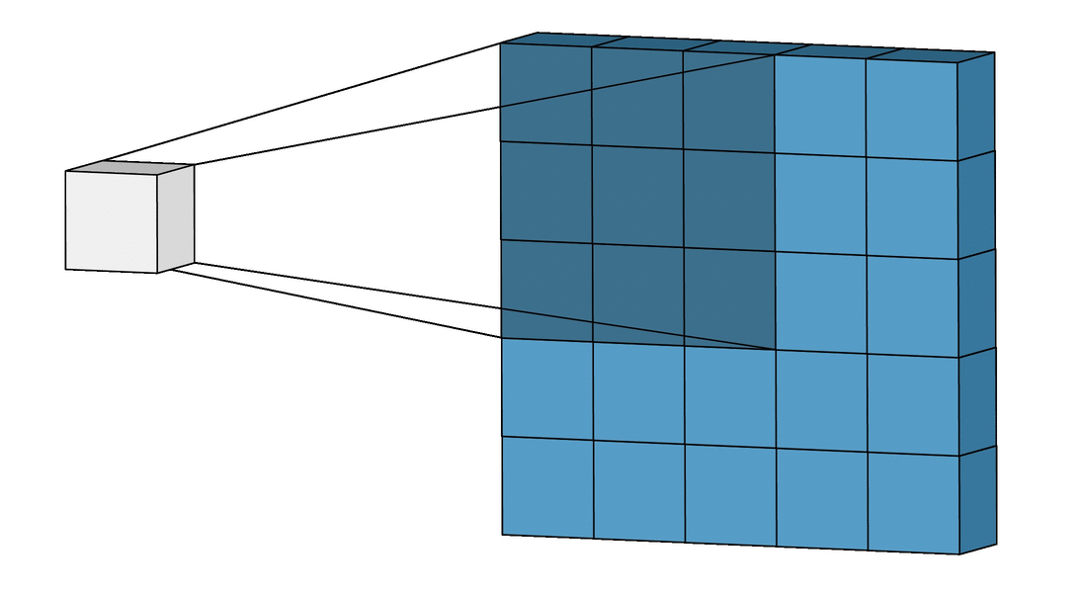
Valid Padding (No Padding)

Slide 30
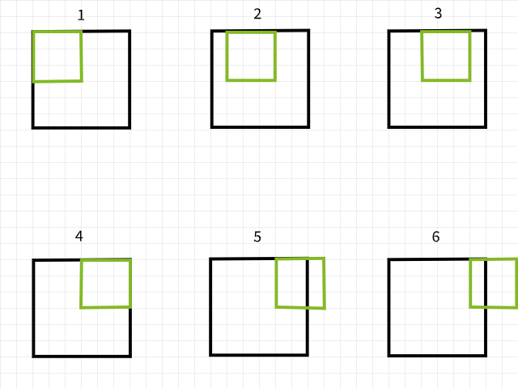
The Lost Pixels

Slide 31

Same Padding

Slide 32
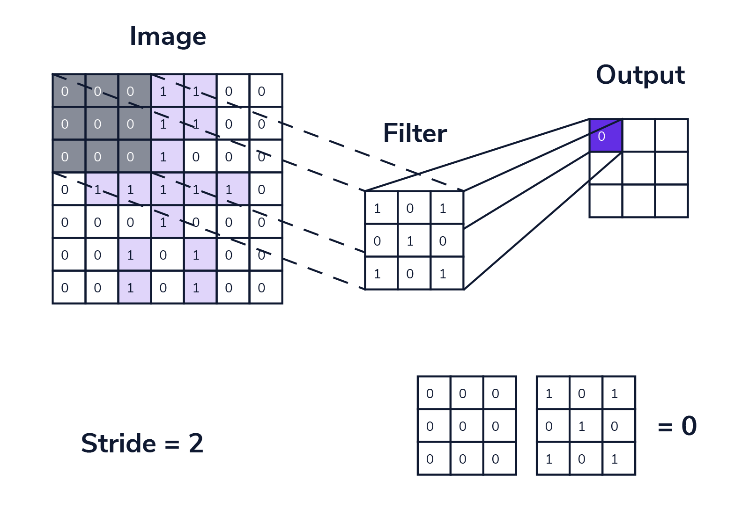
Stride

Slide 33
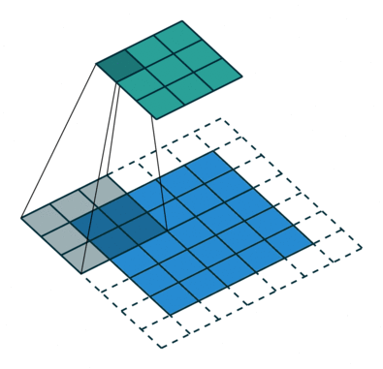
Strided vs Non-Strided Convolution

Slide 34
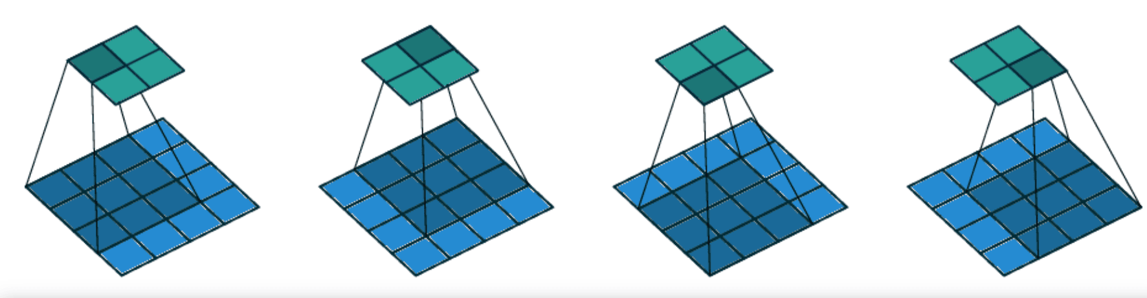
Stride = 1

Slide 35
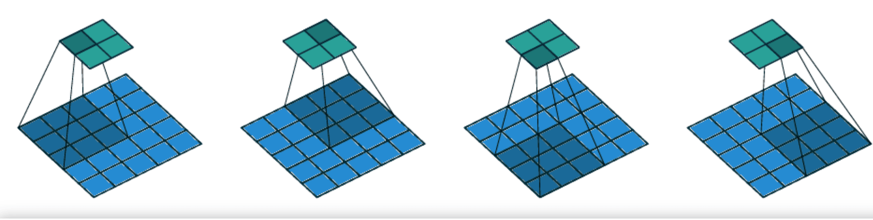
Stride = 2

Slide 36

Stride with and without padding

Slide 37
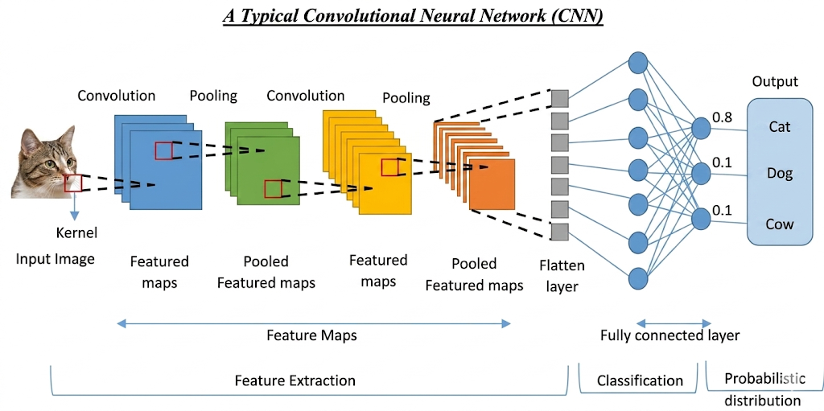

Slide 38
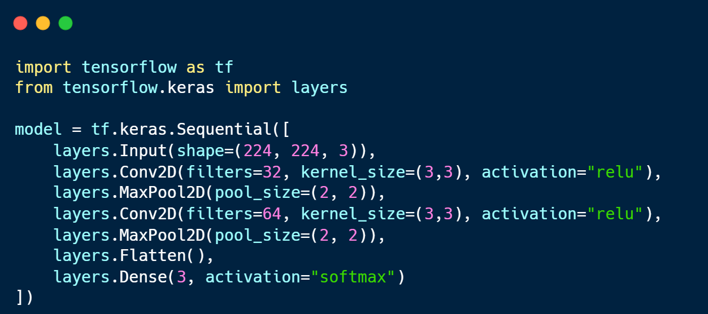

Slide 39
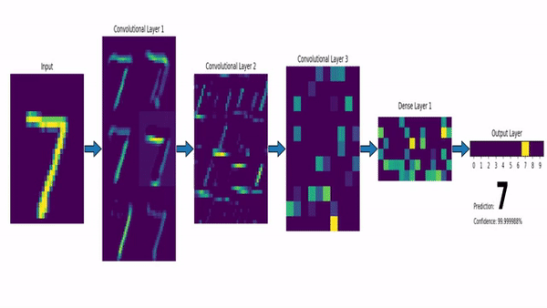
What does a CNN learn from images?

Slide 40
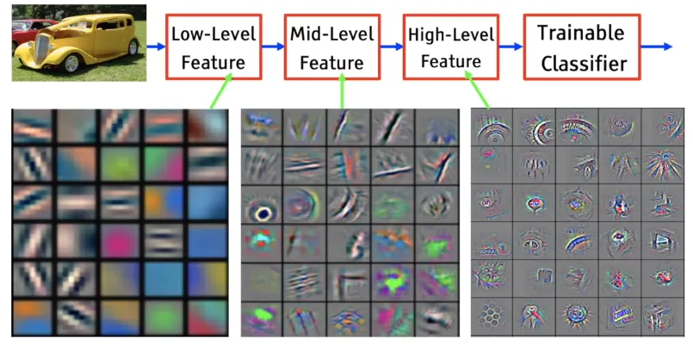

Slide 41
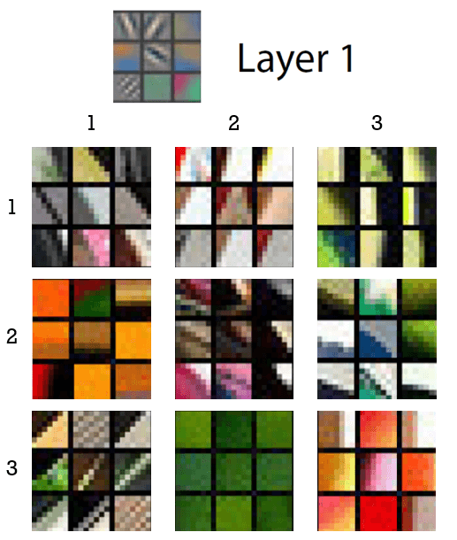

Slide 42
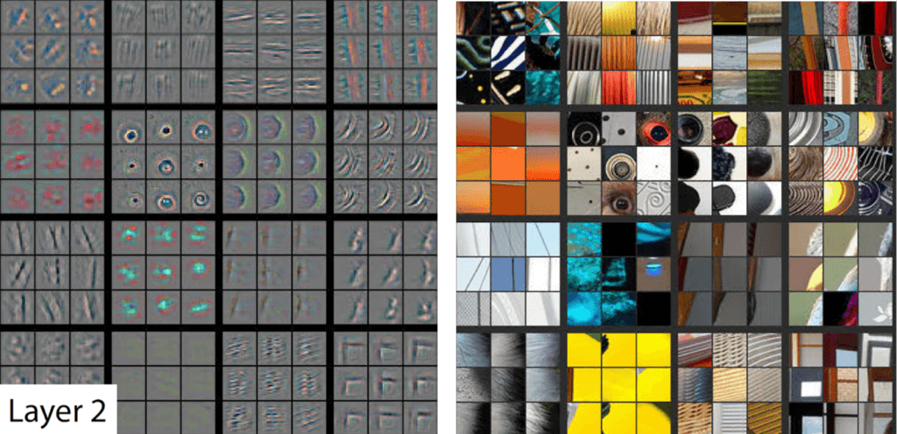

Slide 43
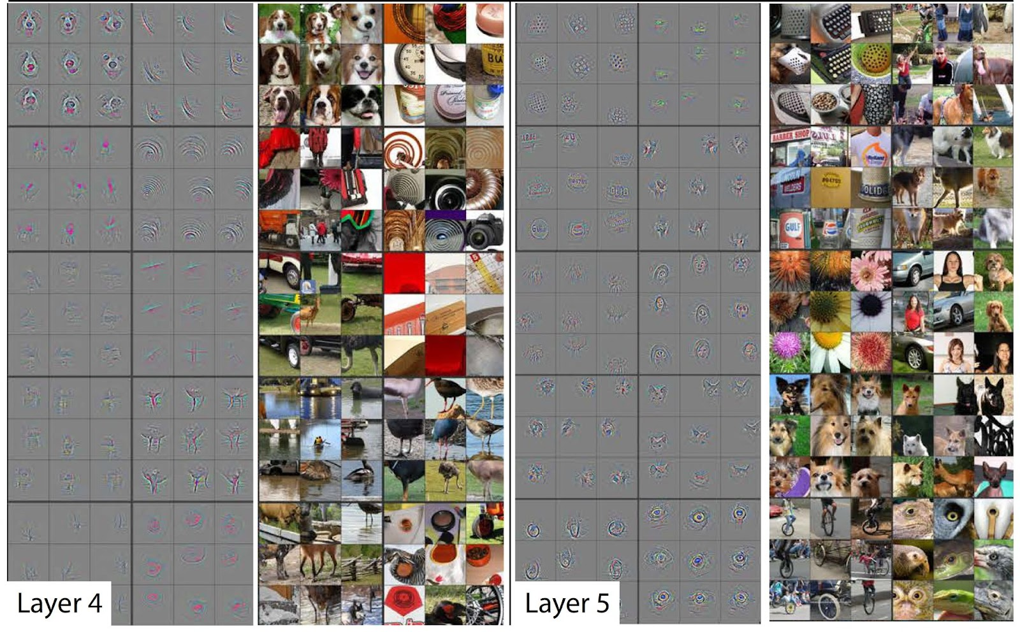

Slide 44
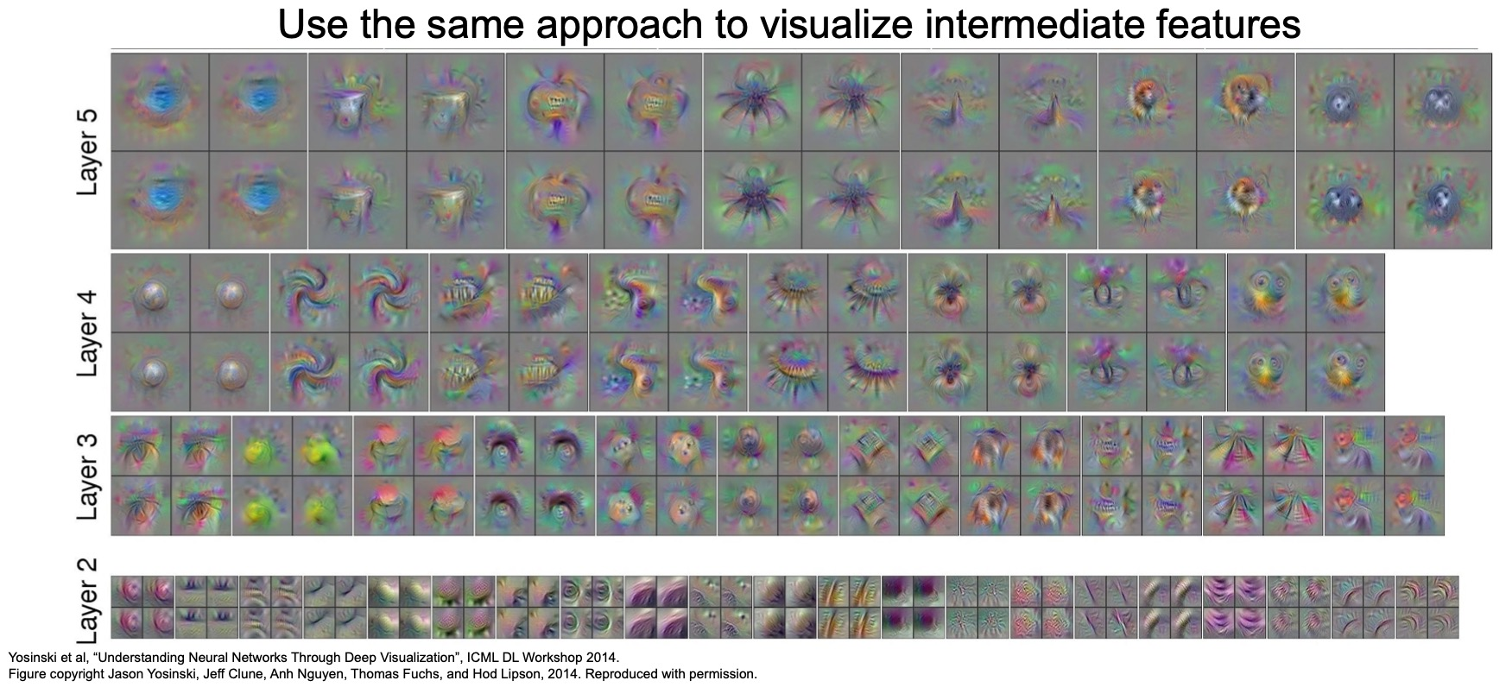

Slide 45
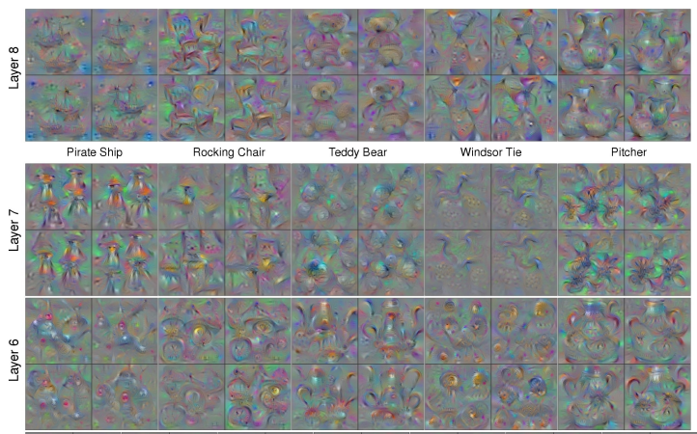

Slide 46
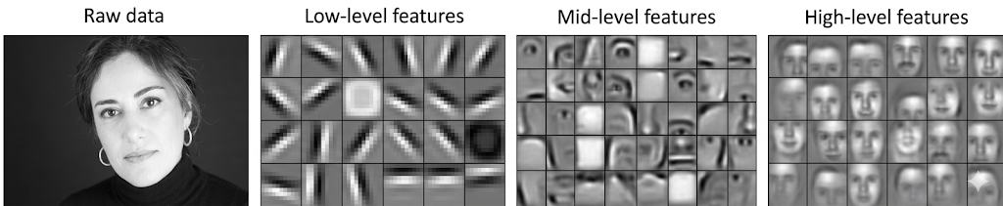

Slide 47
CNN Layer Stage | What it Learns / Detects | Intuition
Input Layer | Raw pixels (RGB values) | Just the image as numbers
Early Convolutional Layers | Edges, lines, corners, simple textures | Detects basic shapes like vertical/horizontal lines
Middle Convolutional Layers | Patterns, parts of objects (eyes, wheels, fur, curves) | Combines edges into meaningful parts
Deep Convolutional Layers | High-level object structures (faces, animals, cars) | Understands “what object is present”
Fully Connected Layers | Final decision / classification | Uses learned features to predict label

Slide 48
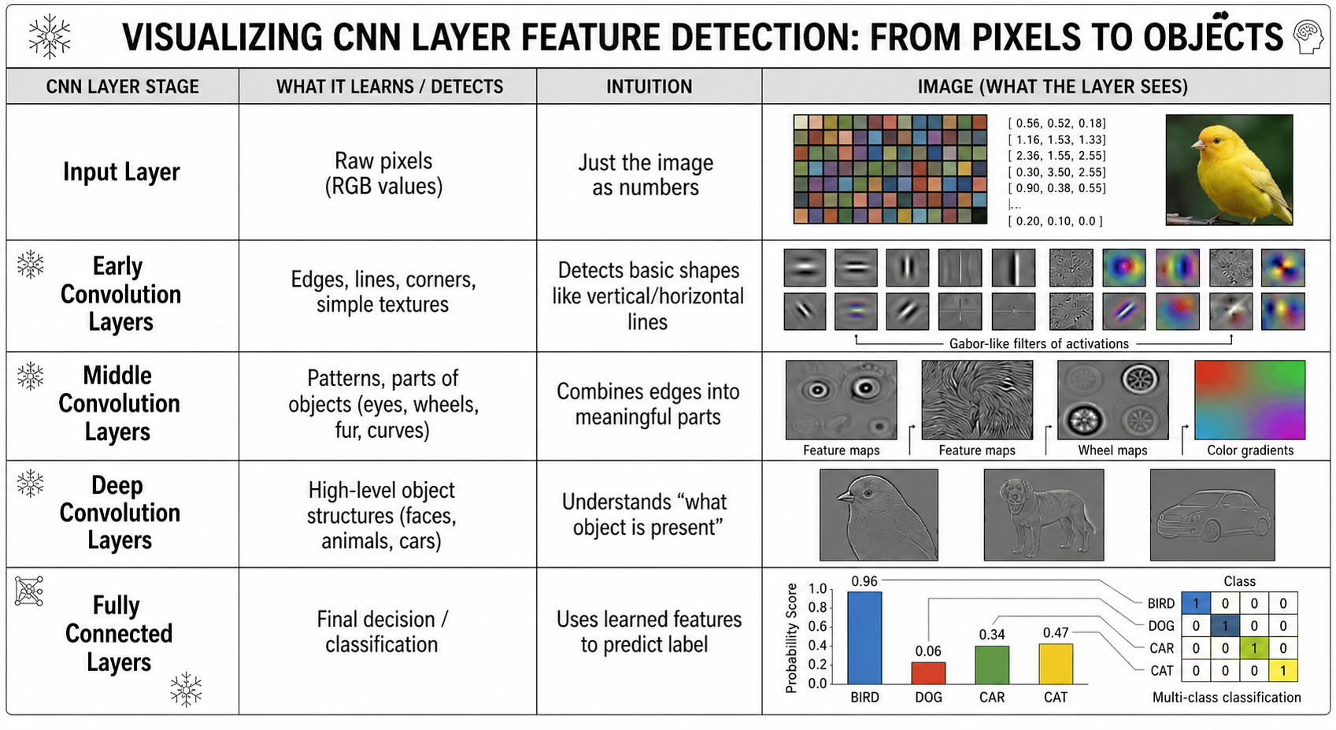

Slide 49
Thank You

